Slide 1
Module-4:
Exception Handling and Errors
All the issues ignored during the Compilation Process

Slide 2
What is Exception?:
In Java, Exception is an unwanted or unexpected event, which occurs during the execution of a program, i.e. at run time, that disrupts the normal flow of the program’s instructions.
It is an object that is thrown at runtime when an unexpected situation (error) occurs.
Exception Handling:
Exception handling in Java is a mechanism to manage runtime errors, ensuring that the normal flow of the application is maintained. It allows a program to deal with unexpected events or errors without crashing.

Slide 3
What is Error:
Exceptional conditions that the application cannot normally predict or recover from. They are also ignored throughout the compilation process.
Errors represent irrecoverable conditions such as Java virtual machine (JVM) running out of memory, memory leaks, stack overflow errors, library incompatibility, infinite recursion, etc. Errors are usually beyond the control of the programmer, and we should not try to handle errors.
Some examples of errors:
OutOfMemoryError
VirtualMachineErrors
AssertionError

Slide 4
Diff between Error and Exception:
Error: Represents serious, unrecoverable issues that occur in the runtime environment. Errors are usually external to the application and indicate a problem that the application cannot handle or recover from (e.g., memory exhaustion, system crashes).
Exception: Represents conditions that a program might want to catch and handle. These are usually conditions that arise because of logical or runtime issues in the application (e.g., invalid user input, I/O problems, divide by zero).

Slide 5
Exception Hierarchy:
All exception and error types are subclasses of the class Throwable, which is the base class of the hierarchy. One branch is headed by Exception. This class is used for exceptional conditions that user programs should catch. NullPointerException is an example of such an exception. Another branch, Error is used by the Java run-time system(JVM) to indicate errors having to do with the run-time environment itself(JRE).

Slide 6
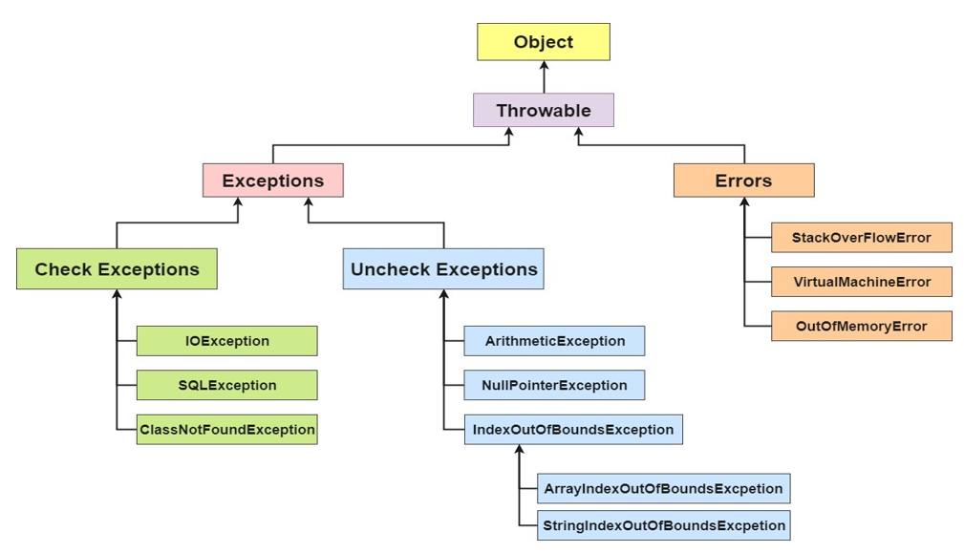
Exception Hierarchy

Slide 7
Checked or compiled-time exceptions:
Arise when something goes wrong in your code but is potentially recoverable. Checked at compilation time.
Some checked Exceptions include:
SQLException: It occurs due to various database-related issues
IOException: Occurs when an input-output operation fails or is interrupted.
ClassNotFoundException: When The class is not available in the classpath or the class file is missing.
FileNotfound Exception: When The specified file does not exist
Handling:
Must be caught or declared because it’s a checked exception.
Usually handled in a try-catch block where database queries are executed.

Slide 8
2. Unchecked or Runtime Exceptions in Java:
Unchecked exceptions are classes that inherit from RuntimeException. They are not tested at compile time, but rather during runtime.
Some unchecked exceptions include:
ArithmeticException: This exception is thrown when an illegal arithmetic operation is attempted, such as division by zero
NullPointerException: This exception is thrown when an application tries to use a null object reference where an object is required.
ArrayIndexOutOfBoundsException: This exception is thrown when you try to access an array with an invalid index, such as a negative index or an index greater than or equal to the array size.
NumberFormatException: This exception is thrown when an attempt is made to convert a string to a number
InputMismatchException: This exception is thrown when an attempt is made to read data of the wrong type using a scanner. For example, if you try to read an integer but provide a non-numeric input.

Slide 9
Classification of Exceptions:
In Java, exceptions are classified into two broad categories: Checked Exceptions and Unchecked Exceptions. These exceptions are further divided into different types based on their hierarchy and how they are handled.

Slide 10
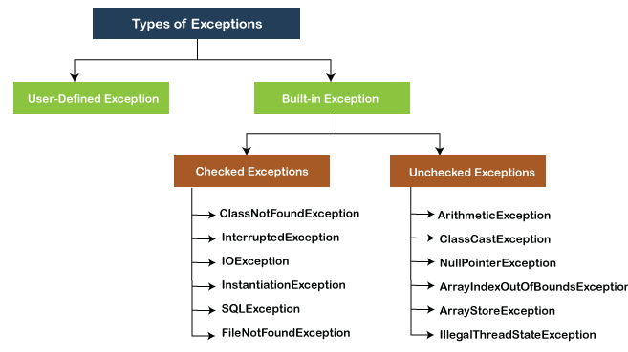
Classification of Exceptions:

Slide 11
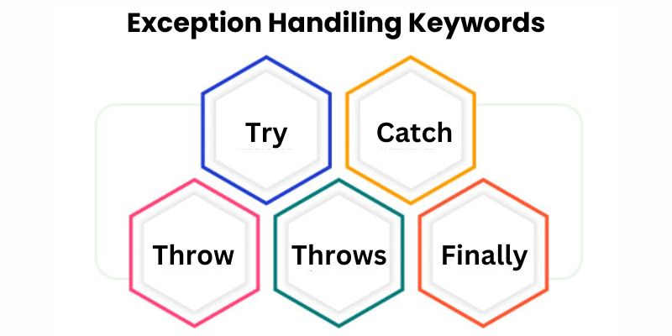
Important Keywords Related to Java Exception Handling:
In Java, exception handling is done using try, catch, throw, throws, and finally. These constructs allow you to handle runtime errors gracefully.

Slide 12
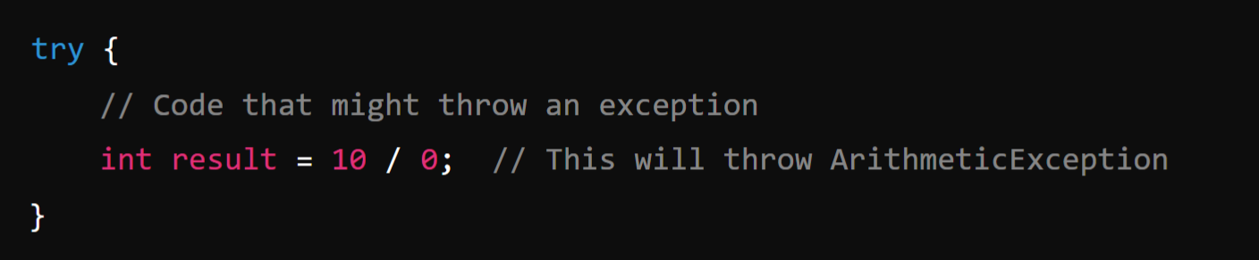
1. try: (Holds Risky Code)
The try block contains the code that might throw an exception. If an exception occurs, it jumps to the catch block.
The try block is the block where the block of code that is needed to be checked for exceptions is placed. The try block is followed by a catch or finally block, it cannot stand alone.
Example:

Slide 13
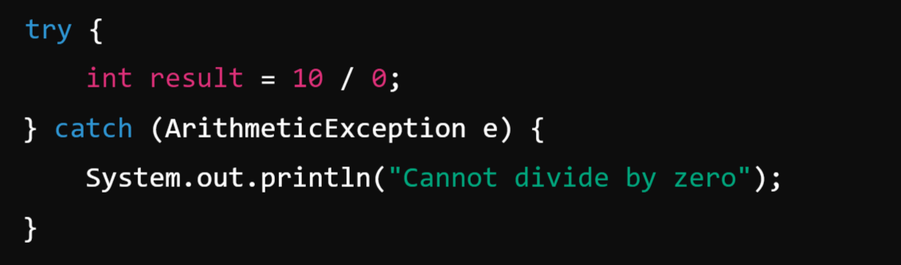
2. catch:
The catch block is used to handle the exception thrown by the try block. You can catch different types of exceptions by chaining multiple catch blocks. It is declared after the try block.
Example:

Slide 14
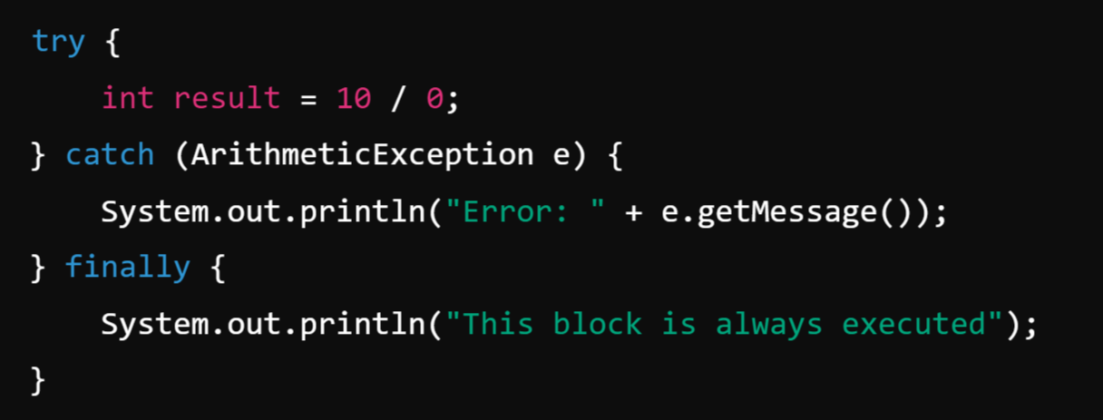
3. finally:
The finally block contains code that will always execute after the try and catch blocks, regardless of whether an exception was thrown. It is typically used for cleanup actions, like closing resources.
Using the finally block we can execute an important piece of code because the finally block will be executed regardless of what the outcome is from the try block.
Example:

Slide 15
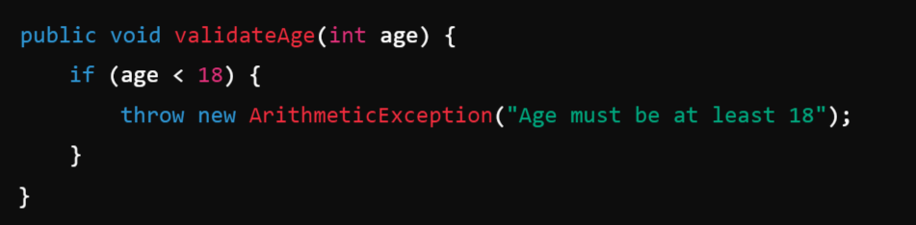
4. throw:
The throw keyword is used to explicitly throw an exception.
Using the throw keyword we can throw a predefined exception.
Example:

Slide 16
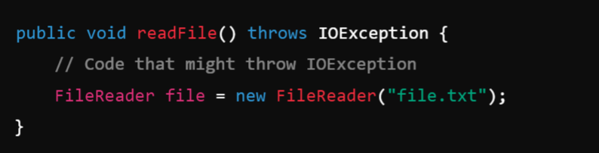
5. throws:
The throws keyword is used in method signatures to declare that a method might throw one or more exceptions. This is useful for checked exceptions.
Example:

Slide 17
Creating own Exception sub-classes:
In Java, you can create your own custom exception classes by extending the built-in Exception class (for checked exceptions) or RuntimeException class (for unchecked exceptions). Custom exceptions are useful when you want to throw specific errors related to your application's business logic.
Steps to Create a Custom Exception Class:
Extend the Exception class (for checked exceptions) or RuntimeException class (for unchecked exceptions).
Provide constructors to initialize the exception message and optionally pass other information like the cause of the exception.

Slide 18
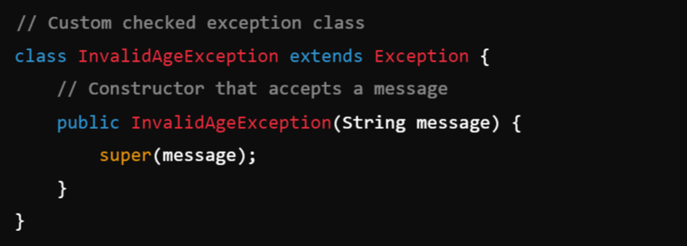
1. Creating a Custom Checked Exception:
A checked exception must be declared in the method signature using the throws keyword and must be handled (caught) in the calling method.
Example:

Slide 19
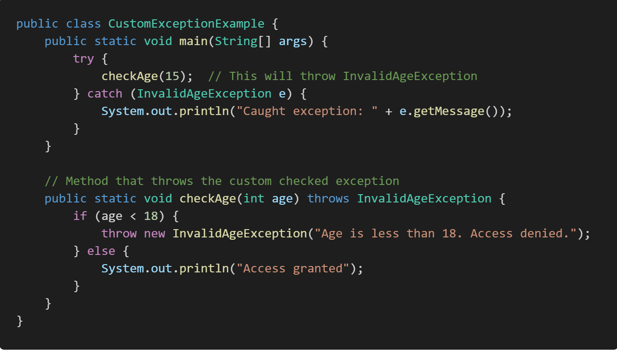

Slide 20
Explanation:
InvalidAgeException is a custom checked exception that must be declared in the method signature (throws InvalidAgeException).
When the age is less than 18, an InvalidAgeException is thrown with a custom message.
The calling method (main()) must catch or declare this exception.

Slide 21
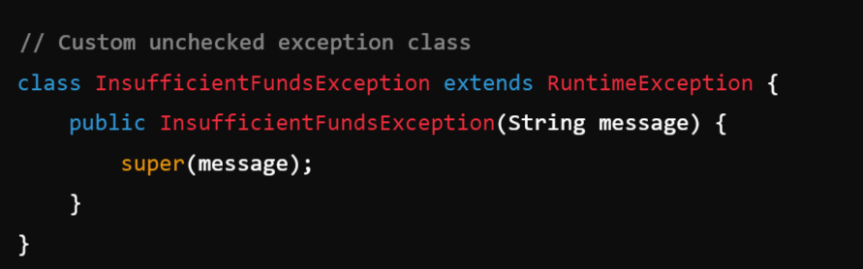
2. Creating a Custom Unchecked Exception
An unchecked exception is created by extending RuntimeException. Unlike checked exceptions, these do not need to be declared in the method signature or caught.
Example: Creating a Custom Unchecked Exception

Slide 22
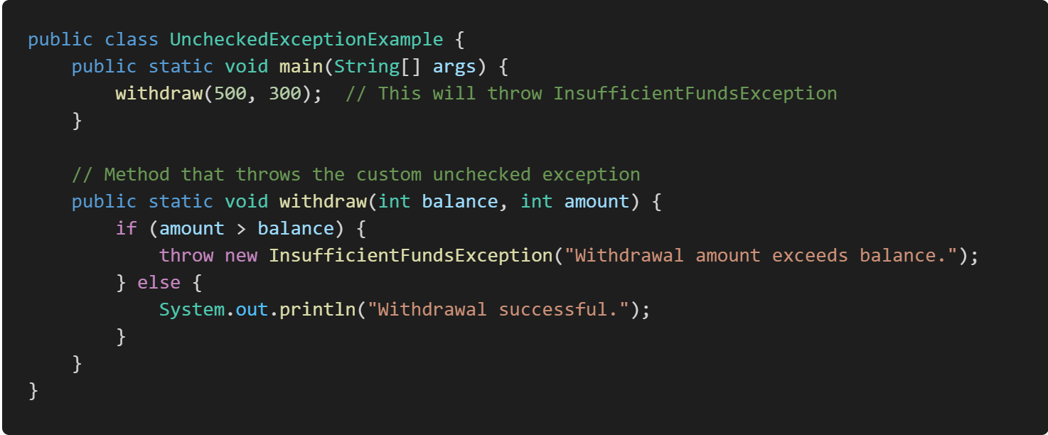
Explanation:
InsufficientFundsException is a custom unchecked exception (subclass of RuntimeException).
In this case, if the withdrawal amount exceeds the balance, an InsufficientFundsException is thrown.
This exception does not need to be declared in the method signature, nor does it need to be caught unless the developer chooses to.

Slide 23
Rethrowing Exceptions:
Rethrowing exceptions in Java refers to the practice of catching an exception in a catch block and then throwing it again, allowing it to propagate up the call stack. This is often done after logging or modifying the exception.
Two Ways to Achieve:
Rethrow without modification
Rethrow with modification

Slide 24
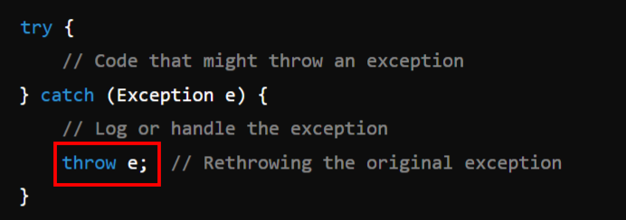
Rethrow without modification: The caught exception is simply thrown again, allowing it to propagate unchanged.
Example:

Slide 25
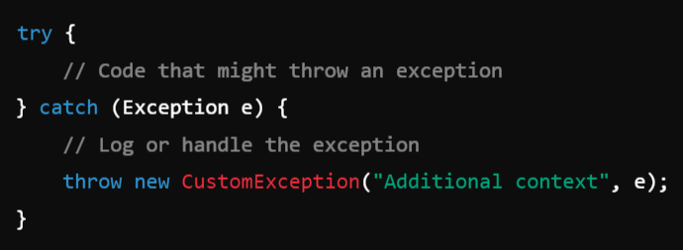
2. Rethrow with modification: You can throw a new exception or wrap the original one in a new exception, which adds more context or a custom message.
Example:

Slide 26
Exception Specification:
In Java, exception specification refers to the declaration of exceptions that a method might throw.
This is done using the throws keyword in the method signature, which informs the caller of the method about the exceptions that could be thrown and that the caller must handle or propagate these exceptions.

Slide 27
Types of Exceptions in Java:
1. Checked Exceptions:
These are exceptions that are checked at compile-time.
A method must either handle these exceptions using a try-catch block or specify them in the method signature using throws.
Example: IOException, SQLException.
2. Unchecked Exceptions: (Exception Specification Not Required)
These are exceptions that are not checked at compile-time, usually derived from RuntimeException.
Methods are not required to specify unchecked exceptions in their throws clause as they are propagated automatically.
Example: NullPointerException, ArithmeticException.

Slide 28
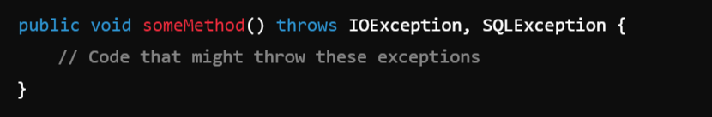
Syntax of Exception Specification:
A method can specify the exceptions it throws using the throws keyword.
Syntax:

Slide 29
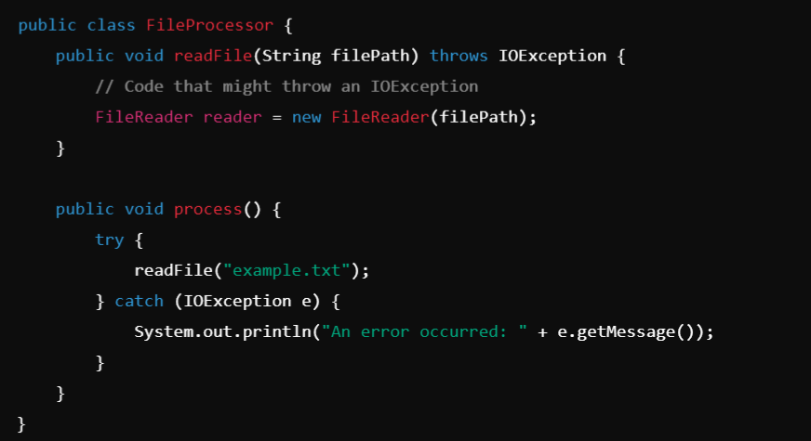
Example: In this example:
The readFile method specifies that it might throw an IOException.
The process method catches and handles the IOException.

Slide 30
Module-4: EXCEPTION HANDLING (5hrs)
Exception Handling: Benefits of exception handling, the classification of exceptions, exception hierarchy, checked exceptions and unchecked exceptions, usage of try, catch, throw, throws and finally. rethrowing exceptions, exception specification, built in exceptions, creating own exception sub classes.
Module-5: GUI PROGRAMMING AND APPLETS (6)
GUI Programming with Java: The AWT class hierarchy, introduction to swing. swangs Vs AWT, hierarchy for swing components.
Containers: JFrame. JApplet, JDialog. Jpanel, overview of some swing components JButton, JLabel, JTextField, JTextArea, simple applications Layout management Layout manager types, border, grid and flow.
Applets: Inheritance hierarchy for applets, differences between applets and applications, life cycle of an applet, passing parameters to applets.

Slide 32
Benefits of exception handling
Exception handling in Java provides several important benefits, making applications more robust, maintainable, and reliable. Here are the key benefits:
1. Improved Program Flow
Prevents Crashes: By catching exceptions, you can handle errors gracefully without crashing the entire program. This enables the program to continue executing after encountering an exception.
Separation of Error-Handling Code: Exception handling separates normal code from error-handling code, making the code cleaner and easier to maintain.

Slide 33
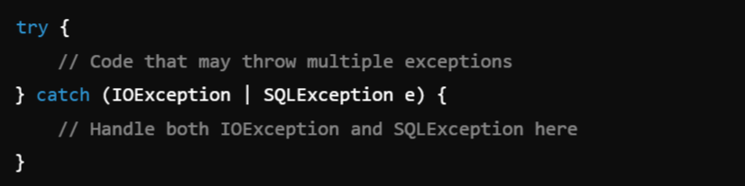
2. Grouped Error Handling:
Catching Multiple Exceptions: A single try-catch block can handle multiple types of exceptions. You can group related exceptions to be handled in one place, reducing redundancy and simplifying error handling.
Example:

Slide 34
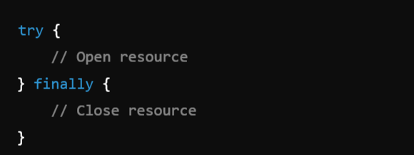
3. Cleaner Code Using finally Block:
Guaranteed Cleanup: The finally block ensures that resources such as file streams, database connections, or network sockets are properly closed, regardless of whether an exception occurs. This prevents resource leaks and ensures that important cleanup tasks are always performed.

Slide 35
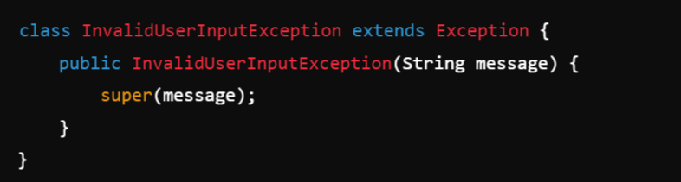
4. Custom Exceptions:
Create User-Defined Exceptions: Java allows you to create custom exceptions by extending the Exception class. This feature enables you to throw and catch meaningful exceptions specific to your application's domain (e.g., InvalidUserInputException, TransactionFailedException).

Slide 36
5. Code Maintainability
Modular and Readable Code: Exception handling makes your code modular, meaning you can focus on the core functionality in one section of the code and handle errors in another section. This leads to cleaner, more readable, and maintainable code.
6. Helps in Debugging
Exception Stack Traces: When an exception is thrown, Java provides a detailed stack trace that shows exactly where the error occurred and what methods were involved. This information can be crucial for debugging and identifying the root cause of issues.
7. Supports Legacy Code Integration
Handle Legacy Code Failures: Exception handling allows smooth integration with older, error-prone code by providing a structured way to manage its errors without disrupting modern applications.

